Slide 1
Final
Presentation
Haotian Wu
Data gathered from https://data.wprdc.org/dataset/fire-incidents-in-city-of-pittsburgh.
GitHub page: https://github.com/lambkinForever/Haotian-Wu.git

Slide 2
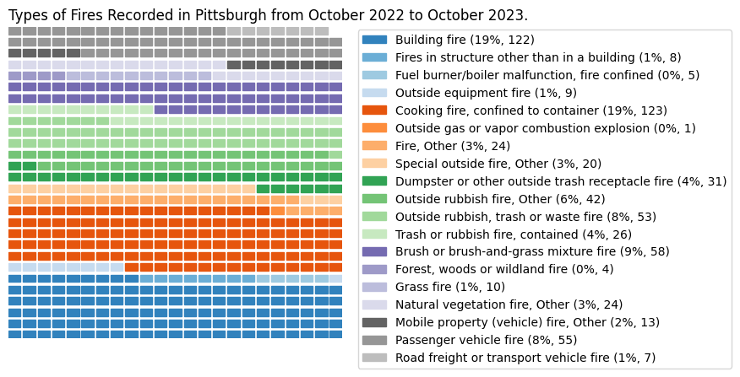
Waffle chart
This is a Waffle Chart representing various types of fire incidents numbers in the Pittsburgh Region from October 2022 to October 2023.
Each block symbolizes a single fire incident. Blocks of varying brightness, yet with a consistent base color, represent the same type of fire.
Blocks of analogous colors signify fires from the same primary category.
The more blocks present, the higher the count of such fires. Conversely, fewer blocks indicate a lower number of fire incidents.

Slide 3
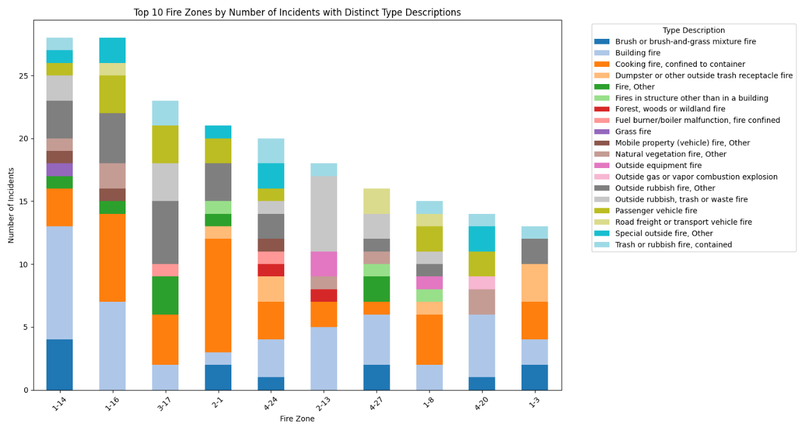
Vertical Bar Chart
Top 10 fire zones by number of incidents with distinct type description
This is a Bar Chart representing Pittsburgh's Top 10 areas with the highest number of fires between October 2022 and October 2023.
Each column is composed of different colors, so you can clearly see the type of ingredient in the fire quantity.
The entire data is presented in descending order for easy reading and the color used is the tab20 light color palette that is not irritating to the eyes.

Slide 4
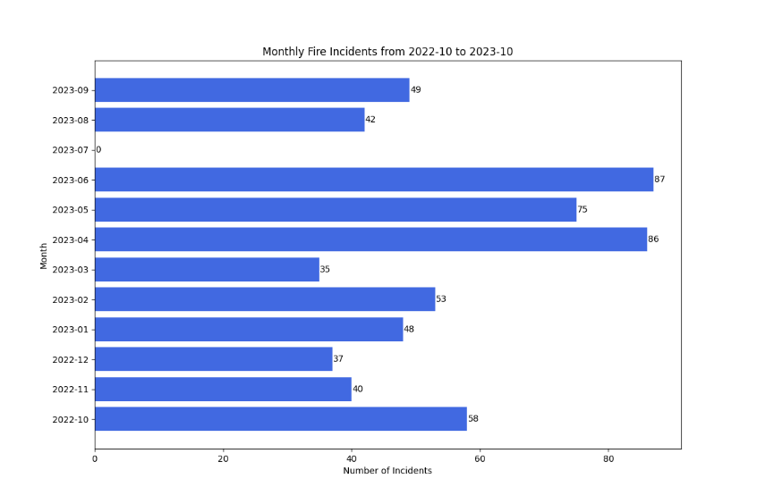
Horizontal Bar Chart
T Monthly fire incidents from 2022-10 to 2023-10
This is a Bar Chart representing Pittsburgh's fire incidents numbers between October 2022 and October 2023.
Using a horizontal bar chart instead of a vertical bar chart allows viewers to easily see the quantity and using royal blue to replace normal blue to make the figure look less irritating to the eyes.
Marking July 2023, which has no data, allows viewers to easily spot anomalies

Slide 5
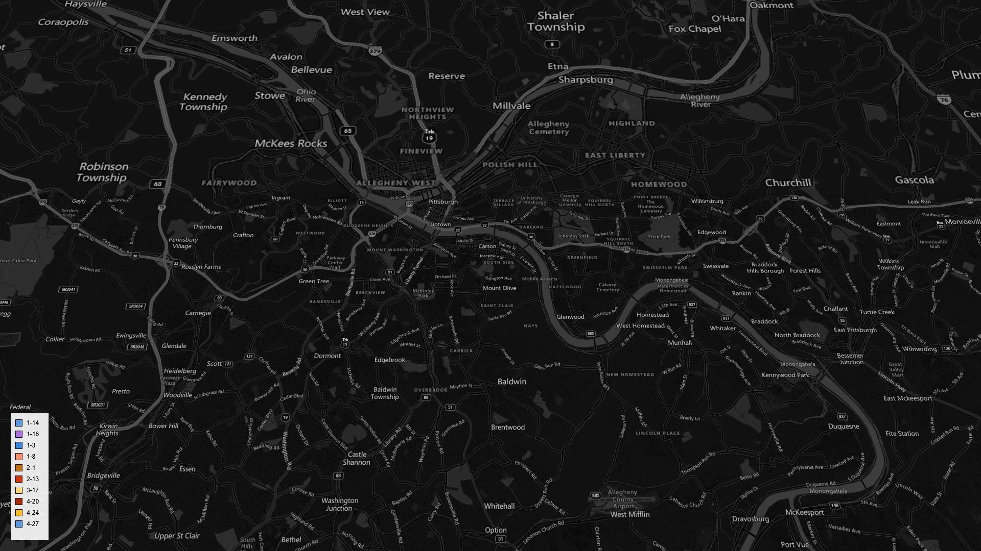
3d Map Bar Graph

Slide 6
Thank you
End of the presentation

